Slide 1
Distributed Databases

Slide 2
Distributed Databases
Heterogeneous and Homogeneous Databases
Distributed Data Storage
Distributed Transactions
Commit Protocols
Concurrency Control in Distributed Databases
Availability
Distributed Query Processing
Heterogeneous Distributed Databases
Directory Systems

Slide 3
Distributed Database System
A distributed database system consists of loosely coupled sites that share no physical component
Database systems that run on each site are independent of each other
Transactions may access data at one or more sites

Slide 4
Homogeneous Distributed Databases
In a homogeneous distributed database
  All sites have identical software
  Are aware of each other and agree to cooperate in processing user requests.
  Each site surrenders part of its autonomy in terms of right to change schemas or software
  Appears to user as a single system
In a heterogeneous distributed database
  Different sites may use different schemas and software
    Difference in schema is a major problem for query processing
    Difference in software is a major problem for transaction processing
  Sites may not be aware of each other and may provide only
  limited facilities for cooperation in transaction processing

Slide 5
Distributed Data Storage
Assume relational data model
Replication
  System maintains multiple copies of data, stored in different sites, for faster retrieval and fault tolerance.
Fragmentation
  Relation is partitioned into several fragments stored in distinct sites
Replication and fragmentation can be combined
  Relation is partitioned into several fragments: system maintains several identical replicas of each such fragment.

Slide 6
Data Replication
A relation or fragment of a relation is replicated if it is stored redundantly in two or more sites.
Full replication of a relation is the case where the relation is stored at all sites.
Fully redundant databases are those in which every site contains a copy of the entire database.

Slide 7
Data Replication (Cont.)
Advantages of Replication
  Availability: failure of site containing relation r does not result in unavailability of r is replicas exist.
  Parallelism: queries on r may be processed by several nodes in parallel.
  Reduced data transfer: relation r is available locally at each site containing a replica of r.
Disadvantages of Replication
  Increased cost of updates: each replica of relation r must be updated.
  Increased complexity of concurrency control: concurrent updates to distinct replicas may lead to inconsistent data unless special concurrency control mechanisms are implemented.
    One solution: choose one copy as primary copy and apply concurrency control operations on primary copy

Slide 8
Data Fragmentation
Division of relation r into fragments r₁, r₂, …, r_{n} which contain sufficient information to reconstruct relation r.
Horizontal fragmentation: each tuple of r is assigned to one or more fragments
Vertical fragmentation: the schema for relation r is split into several smaller schemas
  All schemas must contain a common candidate key (or superkey) to ensure lossless join property.
  A special attribute, the tuple-id attribute may be added to each schema to serve as a candidate key.

Slide 9
Horizontal Fragmentation of account Relation
branch_name
account_number
balance
Hillside
Hillside
Hillside
A-305
A-226
A-155
500
336
62
account₁ = σ_{branch_name=“Hillside”} (account )
branch_name
account_number
balance
Valleyview
Valleyview
Valleyview
Valleyview
A-177
A-402
A-408
A-639
205
10000
1123
750
account₂ = σ_{branch_name=“Valleyview”} (account )

Slide 10
Vertical Fragmentation of employee_info Relation
branch_name
customer_name
tuple_id
Hillside
Hillside
Valleyview
Valleyview
Hillside
Valleyview
Valleyview
Lowman
Camp
Camp
Kahn
Kahn
Kahn
Green
1
2
3
4
5
6
7
deposit₁ = Πbranch_name, customer_name, tuple_id (employee_info )
account_number
balance
tuple_id
A-305
A-226
A-177
A-402
A-155
A-408
A-639
500
336
205
10000
62
1123
750
1
2
3
4
5
6
7
deposit₂ = Πaccount_number, balance, tuple_id (employee_info )

Slide 11
Advantages of Fragmentation
Horizontal:
  allows parallel processing on fragments of a relation
  allows a relation to be split so that tuples are located where they are most frequently accessed
Vertical:
  allows tuples to be split so that each part of the tuple is stored where it is most frequently accessed
  tuple-id attribute allows efficient joining of vertical fragments
  allows parallel processing on a relation
Vertical and horizontal fragmentation can be mixed.
  Fragments may be successively fragmented to an arbitrary depth.

Slide 12
Data Transparency
Data transparency: Degree to which system user may remain unaware of the details of how and where the data items are stored in a distributed system
Consider transparency issues in relation to:
  Fragmentation transparency
  Replication transparency
  Location transparency

Slide 13
Distributed Transactions and 2 Phase Commit

Slide 14
Distributed Transactions
Transaction may access data at several sites.
Each site has a local transaction manager responsible for:
  Maintaining a log for recovery purposes
  Participating in coordinating the concurrent execution of the transactions executing at that site.
Each site has a transaction coordinator, which is responsible for:
  Starting the execution of transactions that originate at the site.
  Distributing subtransactions at appropriate sites for execution.
  Coordinating the termination of each transaction that originates at the site, which may result in the transaction being committed at all sites or aborted at all sites.

Slide 15
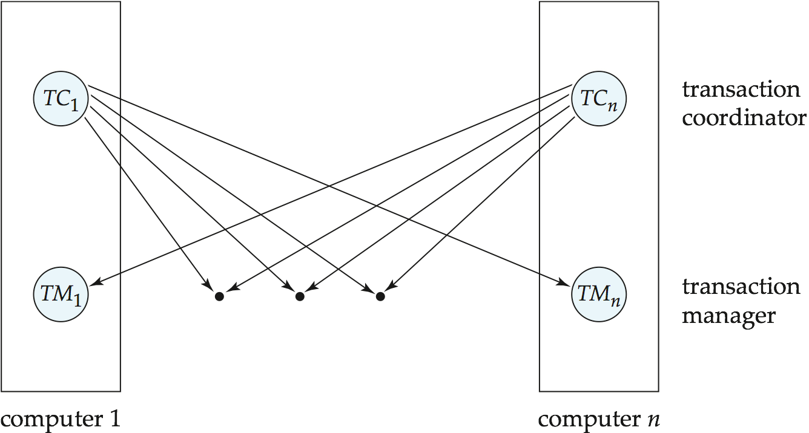
Transaction System Architecture

Slide 16
System Failure Modes
Failures unique to distributed systems:
  Failure of a site.
  Loss of massages
    Handled by network transmission control protocols such as TCP-IP
  Failure of a communication link
    Handled by network protocols, by routing messages via alternative links
  Network partition
    A network is said to be partitioned when it has been split into two or more subsystems that lack any connection between them
      Note: a subsystem may consist of a single node
Network partitioning and site failures are generally indistinguishable.

Slide 17
Commit Protocols
Commit protocols are used to ensure atomicity across sites
  a transaction which executes at multiple sites must either be committed at all the sites, or aborted at all the sites.
  not acceptable to have a transaction committed at one site and aborted at another
The two-phase commit (2PC) protocol is widely used
The three-phase commit (3PC) protocol is more complicated and more expensive, but avoids some drawbacks of two-phase commit protocol. This protocol is not used in practice.

Slide 18
Two Phase Commit Protocol (2PC)
Assumes fail-stop model – failed sites simply stop working, and do not cause any other harm, such as sending incorrect messages to other sites.
Execution of the protocol is initiated by the coordinator after the last step of the transaction has been reached.
The protocol involves all the local sites at which the transaction executed
Let T be a transaction initiated at site S_{i}, and let the transaction coordinator at S_{i} be C_{i}

Slide 19
Phase 1: Obtaining a Decision
Coordinator asks all participants to prepare to commit transaction T_{i}.
  C_{i} adds the records <prepare T> to the log and forces log to stable storage
  sends prepare T messages to all sites at which T executed
Upon receiving message, transaction manager at site determines if it can commit the transaction
  if not, add a record <no T> to the log and send abort T message to C_{i}
  if the transaction can be committed, then:
  add the record <ready T> to the log
  force all records for T to stable storage
  send ready T message to C_{i}

Slide 20
Phase 2: Recording the Decision
T can be committed of C_{i} received a ready T message from all the participating sites: otherwise T must be aborted.
Coordinator adds a decision record, <commit T> or <abort T>, to the log and forces record onto stable storage. Once the record stable storage it is irrevocable (even if failures occur)
Coordinator sends a message to each participant informing it of the decision (commit or abort)
Participants take appropriate action locally.

Slide 21
Handling of Failures - Site Failure
When site S_{i} recovers, it examines its log to determine the fate of
transactions active at the time of the failure.
Log contain <commit T> record: txn had completed, nothing to be done
Log contains <abort T> record: txn had completed, nothing to be done
Log contains <ready T> record: site must consult C_{i} to determine the fate of T.
  If T committed, redo (T); write <commit T> record
  If T aborted, undo (T)
The log contains no log records concerning T:
  Implies that S_{k} failed before responding to the prepare T message from C_{i}
  since the failure of S_{k} precludes the sending of such a response, coordinator C₁ must abort T
  S_{k} must execute undo (T)

Slide 22
Handling of Failures- Coordinator Failure
If coordinator fails while the commit protocol for T is executing then participating sites must decide on T’s fate:
  If an active site contains a <commit T> record in its log, then T must be committed.
  If an active site contains an <abort T> record in its log, then T must be aborted.
  If some active participating site does not contain a <ready T> record in its log, then the failed coordinator C_{i} cannot have decided to commit T.
    Can therefore abort T; however, such a site must reject any subsequent <prepare T> message from C_{i}
  If none of the above cases holds, then all active sites must have a <ready T> record in their logs, but no additional control records (such as <abort T> of <commit T>).
    In this case active sites must wait for C_{i} to recover, to find decision.
Blocking problem: active sites may have to wait for failed coordinator to recover.

Slide 23
Handling of Failures - Network Partition
If the coordinator and all its participants remain in one partition, the failure has no effect on the commit protocol.
If the coordinator and its participants belong to several partitions:
  Sites that are not in the partition containing the coordinator think the coordinator has failed, and execute the protocol to deal with failure of the coordinator.
    No harm results, but sites may still have to wait for decision from coordinator.
The coordinator and the sites are in the same partition as the coordinator think that the sites in the other partition have failed, and follow the usual commit protocol.
    Again, no harm results

Slide 24
Concurrency Control

Slide 25
Concurrency Control
Modify concurrency control schemes for use in distributed environment.
We assume that each site participates in the execution of a commit protocol to ensure global transaction atomicity.
We assume all replicas of any item are updated

Slide 26
Single-Lock-Manager Approach
System maintains a single lock manager that resides in a single chosen site, say S_{i}
When a transaction needs to lock a data item, it sends a lock request to S_{i} and lock manager determines whether the lock can be granted immediately
  If yes, lock manager sends a message to the site which initiated the request
  If no, request is delayed until it can be granted, at which time a message is sent to the initiating site

Slide 27
Single-Lock-Manager Approach (Cont.)
The transaction can read the data item from any one of the sites at which a replica of the data item resides.
Writes must be performed on all replicas of a data item
Advantages of scheme:
  Simple implementation
  Simple deadlock handling
Disadvantages of scheme are:
  Bottleneck: lock manager site becomes a bottleneck
  Vulnerability: system is vulnerable to lock manager site failure.

Slide 28
Distributed Lock Manager
In this approach, functionality of locking is implemented by lock managers at each site
  Lock managers control access to local data items
    But special protocols may be used for replicas
Advantage: work is distributed and can be made robust to failures
Disadvantage: deadlock detection is more complicated
  Lock managers cooperate for deadlock detection
Several variants of this approach
  Primary copy
  Majority protocol
  Biased protocol
  Quorum consensus

Slide 29
Primary Copy
Choose one replica of data item to be the primary copy.
  Site containing the replica is called the primary site for that data item
  Different data items can have different primary sites
When a transaction needs to lock a data item Q, it requests a lock at the primary site of Q.
  Implicitly gets lock on all replicas of the data item
Benefit
  Concurrency control for replicated data handled similarly to unreplicated data - simple implementation.
Drawback
  If the primary site of Q fails, Q is inaccessible even though other sites containing a replica may be accessible.

Slide 30
Majority Protocol
Local lock manager at each site administers lock and unlock requests for data items stored at that site.
When a transaction wishes to lock an unreplicated data item Q residing at site S_{i}, a message is sent to S_{i} ‘s lock manager.
  If Q is locked in an incompatible mode, then the request is delayed until it can be granted.
  When the lock request can be granted, the lock manager sends a message back to the initiator indicating that the lock request has been granted.

Slide 31
Majority Protocol (Cont.)
In case of replicated data
  If Q is replicated at n sites, then a lock request message must be sent to more than half of the n sites in which Q is stored.
  The transaction does not operate on Q until it has obtained a lock on a majority of the replicas of Q.
  When writing the data item, transaction performs writes on all replicas.
Benefit
  Can be used even when some sites are unavailable
Drawback
  Requires 2(n/2 + 1) messages for handling lock requests, and (n/2 + 1) messages for handling unlock requests.
  Potential for deadlock even with single item - e.g., each of 3 transactions may have locks on 1/3rd of the replicas of a data.

Slide 32
Distributed Query Processing

Slide 33
Distributed Query Processing
For centralized systems, the primary criterion for measuring the cost of a particular strategy is the number of disk accesses.
In a distributed system, other issues must be taken into account:
  The cost of a data transmission over the network.
  The potential gain in performance from having several sites process parts of the query in parallel.

Slide 34
Query Transformation
Translating algebraic queries on fragments.
  It must be possible to construct relation r from its fragments
  Replace relation r by the expression to construct relation r from its fragments
Consider the horizontal fragmentation of the account relation into
  account₁ = σ _{branch_name = “Hillside”} (account )
  account₂ = σ _{branch_name = “Valleyview”} (account )
The query σ _{branch_name = “Hillside”} (account ) becomes
  σ _{branch_name = “Hillside”} (account₁ ∪ account₂)
which is optimized into
  σ _{branch_name = “Hillside”} (account₁) ∪ σ _{branch_name = “Hillside”} (account₂)

Slide 35
Example Query (Cont.)
Since account₁ has only tuples pertaining to the Hillside branch, we can eliminate the selection operation.
Apply the definition of account₂ to obtain
σ _{branch_name = “Hillside”} (σ _{branch_name = “Valleyview”} (account )
This expression is the empty set regardless of the contents of the account relation.
Final strategy is for the Hillside site to return account₁ as the result of the query.

Slide 36

Simple Join Processing
Consider the following relational algebra expression in which the three relations are neither replicated nor fragmented
account depositor branch
account is stored at site S₁
depositor at S₂
branch at S₃
For a query issued at site S_{I}, the system needs to produce the result at site S_{I}

Slide 37
Possible Query Processing Strategies
Ship copies of all three relations to site S_{I} and choose a strategy for processing the entire locally at site S_{I.}
Ship a copy of the account relation to site S₂ and compute temp₁ = account depositor at S₂. Ship temp₁ from S₂ to S₃, and compute temp₂ = temp₁ branch at S₃. Ship the result temp₂ to S_{I}.
Devise similar strategies, exchanging the roles S₁, S₂, S₃
Must consider following factors:
  amount of data being shipped
  cost of transmitting a data block between sites
  relative processing speed at each site

Slide 38
Semijoin Strategy
Let r₁ be a relation with schema R₁ stores at site S₁
Let r₂ be a relation with schema R₂ stores at site S₂
Evaluate the expression r₁ r₂ and obtain the result at S₁.
1. Compute temp₁ ← ∏_{R1 ∩ R2} (r1) at S1.
2. Ship temp₁ from S₁ to S₂.
3. Compute temp₂ ← r₂ temp1 at S₂
4. Ship temp₂ from S₂ to S₁.
5. Compute r₁ temp₂ at S₁. This is the same as r₁ r₂.

Slide 39
Formal Definition
The semijoin of r₁ with r₂, is denoted by:
r₁ r₂
it is defined by:
∏_{R1} (r₁ r₂)
Thus, r₁ r₂ selects those tuples of r₁ that contributed to r₁ r₂.
In step 3 above, temp₂=r₂ r₁.
For joins of several relations, the above strategy can be extended to a series of semijoin steps.

Slide 40
Join Strategies that Exploit Parallelism
Consider r₁ r₂ r₃ r₄ where relation ri is stored at site S_{i}. The result must be presented at site S₁.
r₁ is shipped to S₂ and r₁ r₂ is computed at S₂: simultaneously r₃ is shipped to S₄ and r₃ r₄ is computed at S₄
S₂ ships tuples of (r₁ r₂) to S₁ as they produced;
S₄ ships tuples of (r₃ r₄) to S₁
Once tuples of (r₁ r₂) and (r₃ r₄) arrive at S₁ (r₁ r₂) (r₃ r₄) is computed in parallel with the computation of (r₁ r₂) at S₂ and the computation of (r₃ r₄) at S₄.

Slide 41
End of Chapter

